Slide 1
Even More Normalization
DBS201

Slide 2
Agenda:
Foreign Keys
FK Example: Customer and Sales Rep
3. Three ways to detect a Foreign Key
4. Normalization Example
5. A first-look at Merging Relations

Slide 3


Foreign Keys Support “1-to-Many” Relationships
Foreign Keys Are Used to Look Up Information in another relation

Slide 4
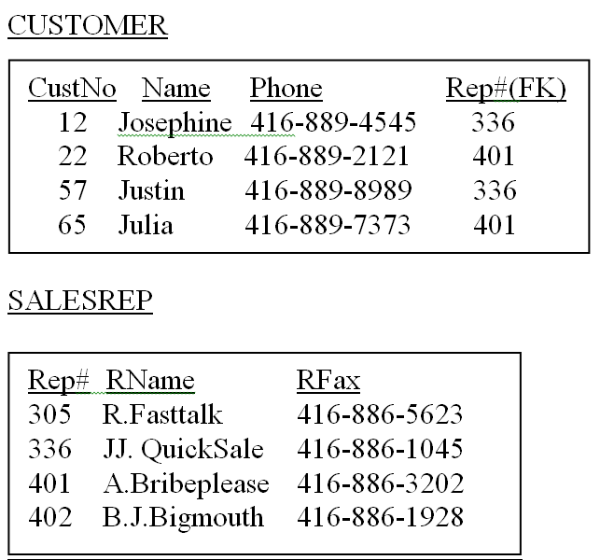
Example

Slide 5
Three ways to detect a Foreign Key
1. A FK occurs when removing a transitive relation from a 2NF relation.
2. Look at an ERD diagram. Every time there is a 1:M relationship and relational integrity is enforced, it means there is a FK. The Foreign Key is on the relation which is on the Many side of the One-to-Many relationship.
3. Examine all tables in the 3NF solution. If the Primary Key of a relation is present in a second relation, then that attribute in the second relation is a Foreign Key.
* Foreign keys can be made of attributes that are part of the PK as well as non-key attributes.

Slide 6
Normalization Example:
ABC PRINTER COMPANY
Part# | Part_Name | Qty used | Supplier Name | Supplier Phone | Model Description | Unit Price
PF123 | Paper spool | 2 | ABC Plastics | 416-234-2342 | Laserjet Printer | $423.56
LC432 | Laserject cartridge | 4 | Jetson Carbons | 905-434-3333 | Laserjet Printer | $123.00
MT123 | 120v power unit | 1 | ACME Power Supply | 767-232-2221 | Laserjet Printer | $200.00
PF123 | Paper spool | 1 | ABC Plastics | 416-234-2342 | 256 Colour Printer | $89.99
IJ345 | Ink jet tray | 3 | Para Inks | 416-323-2345 | 256 Colour Printer | $67.00
MT123 | 120v power unit | 1 | ACME Power Supply | 767-232-2221 | 256 Colour Printer | $200.00

Slide 7
Normalization Example:
ABC PRINTER COMPANY
Part# | Part_Name | Qty used | Supplier Name | Supplier Phone | Model Description | Unit Price
PF123 | Paper spool | 2 | ABC Plastics | 416-234-2342 | Laserjet Printer | $423.56
LC432 | Laserject cartridge | 4 | Jetson Carbons | 905-434-3333 | Laserjet Printer | $123.00
MT123 | 120v power unit | 1 | ACME Power Supply | 767-232-2221 | Laserjet Printer | $200.00
PF123 | Paper spool | 1 | ABC Plastics | 416-234-2342 | 256 Colour Printer | $89.99
IJ345 | Ink jet tray | 3 | Para Inks | 416-323-2345 | 256 Colour Printer | $67.00
MT123 | 120v power unit | 1 | ACME Power Supply | 767-232-2221 | 256 Colour Printer | $200.00
UNF: [ model#, modelDesc, (part#, part_name, qty, suppName, suppPhone, unitPrice) ]

Slide 8
Normalization Example:
ABC PRINTER COMPANY
Part# | Part_Name | Qty used | Supplier Name | Supplier Phone | Model Description | Unit Price
PF123 | Paper spool | 2 | ABC Plastics | 416-234-2342 | Laserjet Printer | $423.56
LC432 | Laserject cartridge | 4 | Jetson Carbons | 905-434-3333 | Laserjet Printer | $123.00
MT123 | 120v power unit | 1 | ACME Power Supply | 767-232-2221 | Laserjet Printer | $200.00
PF123 | Paper spool | 1 | ABC Plastics | 416-234-2342 | 256 Colour Printer | $89.99
IJ345 | Ink jet tray | 3 | Para Inks | 416-323-2345 | 256 Colour Printer | $67.00
MT123 | 120v power unit | 1 | ACME Power Supply | 767-232-2221 | 256 Colour Printer | $200.00
UNF: [ model#, modelDesc, (part#, part_name, qty, suppName, suppPhone, unitPrice) ]
1NF: MODEL [ model#, modelDesc ]
MODEL_PART [ model#, part#, part_name, qty, suppName, suppPhone, unitPrice) ]

Slide 9
Normalization Example:
ABC PRINTER COMPANY
Part# | Part_Name | Qty used | Supplier Name | Supplier Phone | Model Description | Unit Price
PF123 | Paper spool | 2 | ABC Plastics | 416-234-2342 | Laserjet Printer | $423.56
LC432 | Laserject cartridge | 4 | Jetson Carbons | 905-434-3333 | Laserjet Printer | $123.00
MT123 | 120v power unit | 1 | ACME Power Supply | 767-232-2221 | Laserjet Printer | $200.00
PF123 | Paper spool | 1 | ABC Plastics | 416-234-2342 | 256 Colour Printer | $89.99
IJ345 | Ink jet tray | 3 | Para Inks | 416-323-2345 | 256 Colour Printer | $67.00
MT123 | 120v power unit | 1 | ACME Power Supply | 767-232-2221 | 256 Colour Printer | $200.00
UNF: [ model#, modelDesc, (part#, part_name, qty, suppName, suppPhone, unitPrice) ]
1NF: MODEL [ model#, modelDesc ]
MODEL_PART [ model#, part#, part_name, qty, suppName, suppPhone, unitPrice) ]
2NF: MODEL [ model#, modelDesc ]
PART [ part#, part_name, unitPrice ]
MODEL_PART [ model#, part#, qty, suppName, suppPhone ]

Slide 10
Normalization Example:
ABC PRINTER COMPANY
Part# | Part_Name | Qty used | Supplier Name | Supplier Phone | Model Description | Unit Price
PF123 | Paper spool | 2 | ABC Plastics | 416-234-2342 | Laserjet Printer | $423.56
LC432 | Laserject cartridge | 4 | Jetson Carbons | 905-434-3333 | Laserjet Printer | $123.00
MT123 | 120v power unit | 1 | ACME Power Supply | 767-232-2221 | Laserjet Printer | $200.00
PF123 | Paper spool | 1 | ABC Plastics | 416-234-2342 | 256 Colour Printer | $89.99
IJ345 | Ink jet tray | 3 | Para Inks | 416-323-2345 | 256 Colour Printer | $67.00
MT123 | 120v power unit | 1 | ACME Power Supply | 767-232-2221 | 256 Colour Printer | $200.00
UNF: [ model#, modelDesc, (part#, part_name, qty, suppName, suppPhone, unitPrice) ]
1NF: MODEL [ model#, modelDesc ]
MODEL_PART [ model#, part#, part_name, qty, suppName, suppPhone, unitPrice) ]
2NF: MODEL [ model#, modelDesc ]
PART [ part#, part_name, unitPrice]
MODEL_PART [ model#, part#, qty, unitPrice, suppName, suppPhone ]
3NF: MODEL [ model#, modelDesc ]
PART [ part#, part_name, unitPrice ]
MODEL_PART [model# (FK1), part# (FK2), sup#,(FK3), qty ]
SUPPLIER [ supp#, suppName, suppPhone ]

Slide 11
NORMALIZATION - Merging Relations
Understanding how to merge relations is important for three reasons:
On large projects, the work of several sub-teams comes together during logical design, so there is often a need to merge relations.
2. Integrating existing databases with new information requirements often leads to the need to integrate different views.
3. New data requirements may arise during the life cycle, so there is a need to merge any new relations with what has already been developed.

Slide 12
Merging Relations (view integration)
a. As part of the logical design process, normalized relations may have been created from a number of separate ERDs and possibly other user views. There may be bottom-up or parallel database development activities for different areas of the organization as well as top-down ones.
b. The result is that some of the relations generated from these various processes may be redundant; that is, they may refer to the same entities. In such cases, we should merge those relations to remove the redundancy.

Slide 13
Some Terms to Remember
Synonym
- two (or more) attributes that have different names but the same meaning (alias)
Homonym
- an attribute that may have more than one meaning
Transitive Dependency
- When two 3NF relations are merged to form a single relation, transitive dependencies may result.
Enterprise Key
- a primary key whose value is unique across all relations
1. Makes a primary key more like what (in object-oriented databases) is called an object identifier
2. Should be a surrogate key (where the primary key of a relation is a value internal to the database system and has no business meaning).
Multiple Entity Sets --> Final Entity Set

Slide 14
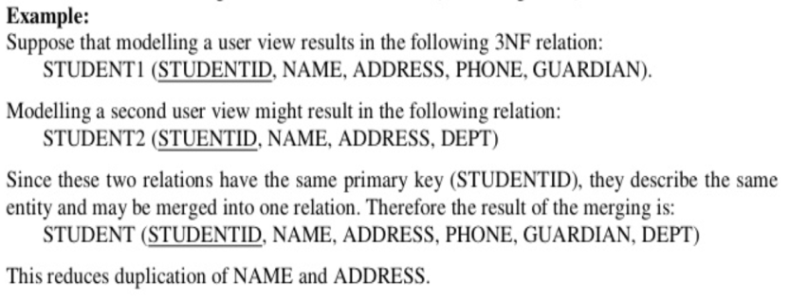
Merging Relations (View Integration)

